Slide 1

6th Grade Accelerated Math
Unit 11, Lesson 7 Solving Real-World Problems with Rational Numbers – Part 3 Volume 2, pg. 195

Slide 2


Benchmark
MA.7.NSO.2.3
Solve real-world problems involving any of the four operations with rational numbers.
volume 2, pg. 195

Slide 3
Integrated Mathematical Thinking and Reasoning Standards
MA.K12.MTR.1.1 Actively participate in effortful learning both individually and collectively.
MA.K12.MTR.3.1 Complete tasks with mathematical fluency.
MA.K12.MTR.4.1 Engage in discussions that reflect on the mathematical thinking of self and others.
MA.K12.MTR.5.1 Use patterns and structure to help understand and connect mathematical concepts.
MA.K12.MTR.7.1 Apply mathematics to real-world contexts.
volume 2, pg. 195

Slide 4

Learning Target
I can solve problems with at least three operations involving any of the four operations with rational numbers.
volume 2, pg. 195

Slide 5

Warm-Up
volume 2, pg. 196

Slide 6
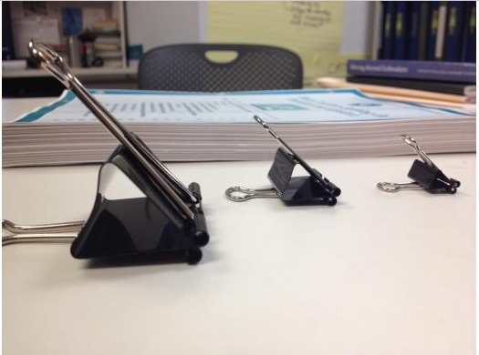
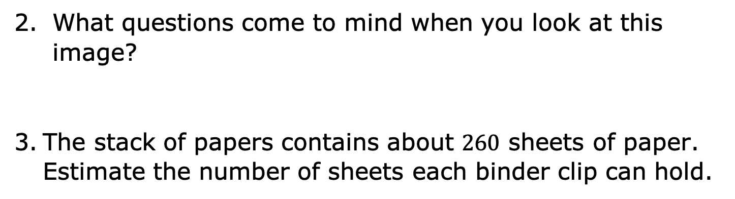
11.7.1 Warm-Up: Notice and Wonder
What do you notice about the binder clips in the image?
What questions come to mind when you look at this image?
The stack of papers contains about $260$ sheets of paper. Estimate the number of sheets each binder clip can hold.
volume 2, pg. 196

Slide 7
To make a good estimate, what information would be useful to know?
What tools or resources could help you find that information?
volume 2, pg. 196

Slide 8

Activity
volume 2, pg. 196

Slide 9

11.7.2 Activity: Gallery Walk
Your teacher will assign your group one of the following scenarios. Work together to answer the question(s), writing neatly on the chart paper provided. Show all your work to prepare a presentation for the other students in your class.
volume 2, pg. 196

Slide 10
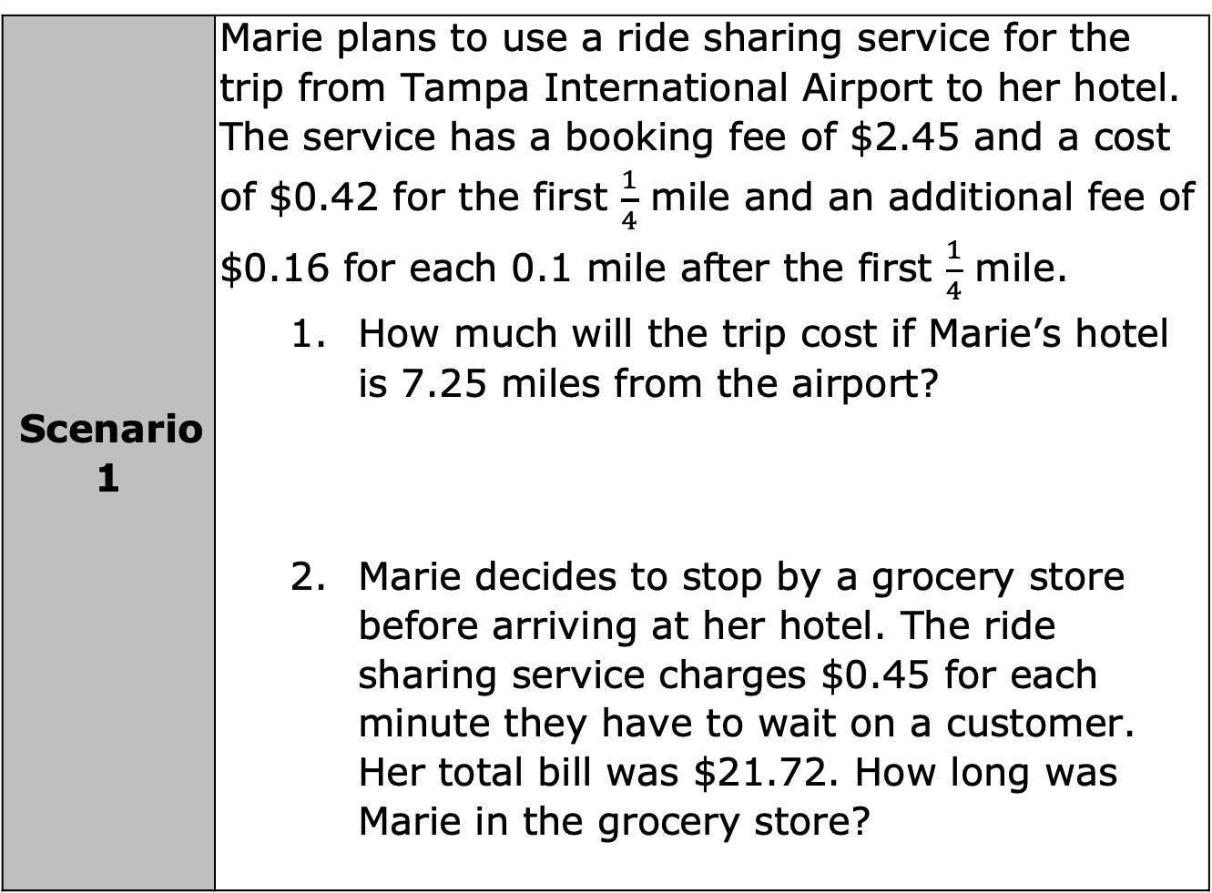
Scenario 1 | Marie plans to use a ride sharing service for the trip from Tampa International Airport to her hotel. The service has a booking fee of $2.45 and a cost of $0.42 for the first $\frac{1}{4}$ mile and an additional fee of $0.16 for each 0.1 mile after the first $\frac{1}{4}$ mile. How much will the trip cost if Marie’s hotel is 7.25 miles from the airport? Marie decides to stop by a grocery store before arriving at her hotel. The ride sharing service charges $0.45 for each minute they have to wait on a customer. Her total bill was $21.72. How long was Marie in the grocery store?
volume 2, pg. 196

Slide 11
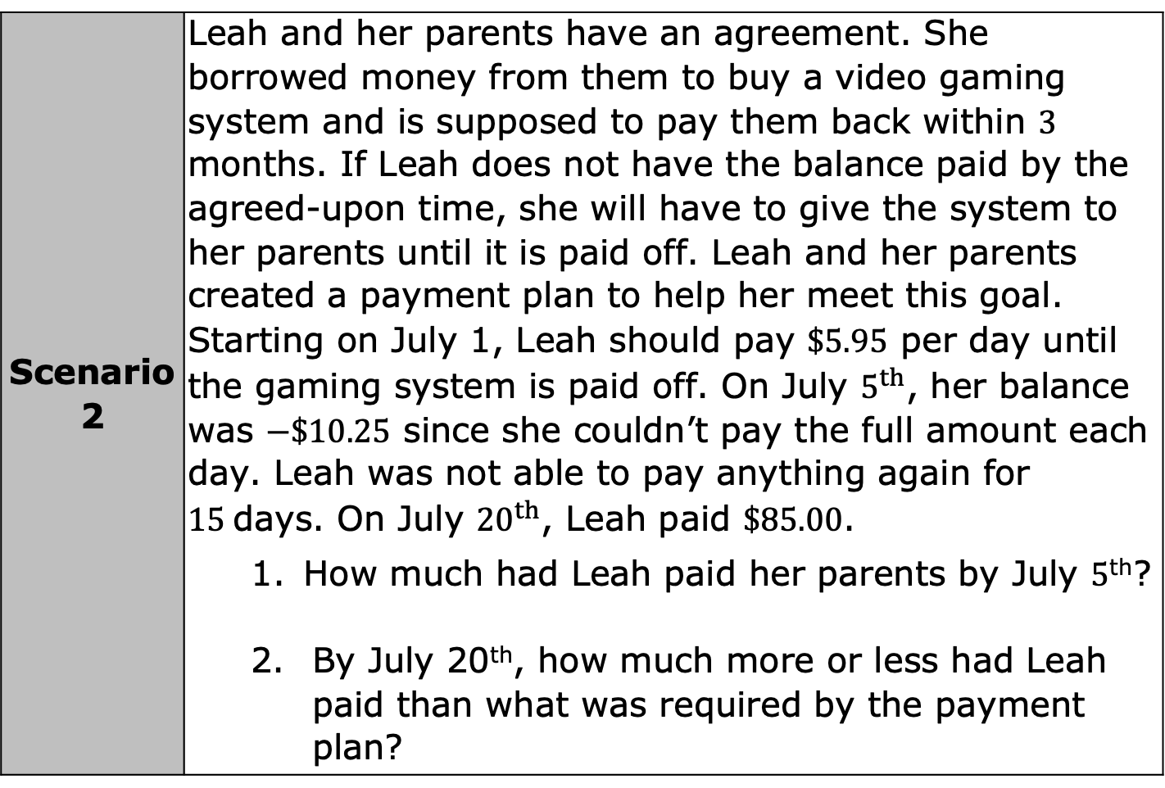
Scenario 2 | Leah and her parents have an agreement. She borrowed money from them to buy a video gaming system and is supposed to pay them back within $3$ months. If Leah does not have the balance paid by the agreed-upon time, she will have to give the system to her parents until it is paid off. Leah and her parents created a payment plan to help her meet this goal. Starting on July 1, Leah should pay $\$5.95$ per day until the gaming system is paid off. On July $5^{th}$, her balance was $−\$10.25$ since she couldn’t pay the full amount each day. Leah was not able to pay anything again for $15$days. On July ${20}^{th}$, Leah paid $\$85.00$. How much had Leah paid her parents by July $5$^{th}? By July 20th, how much more or less had Leah paid than what was required by the payment plan?
volume 2, pg. 197

Slide 12
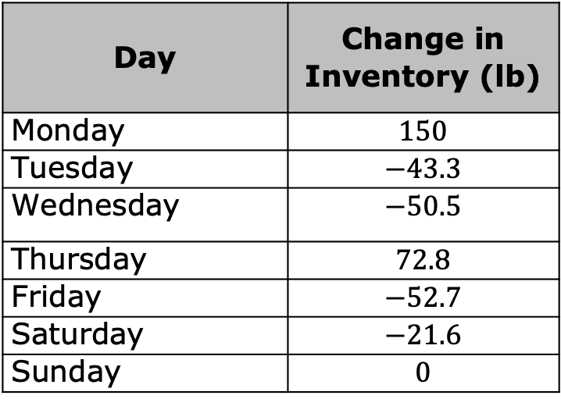
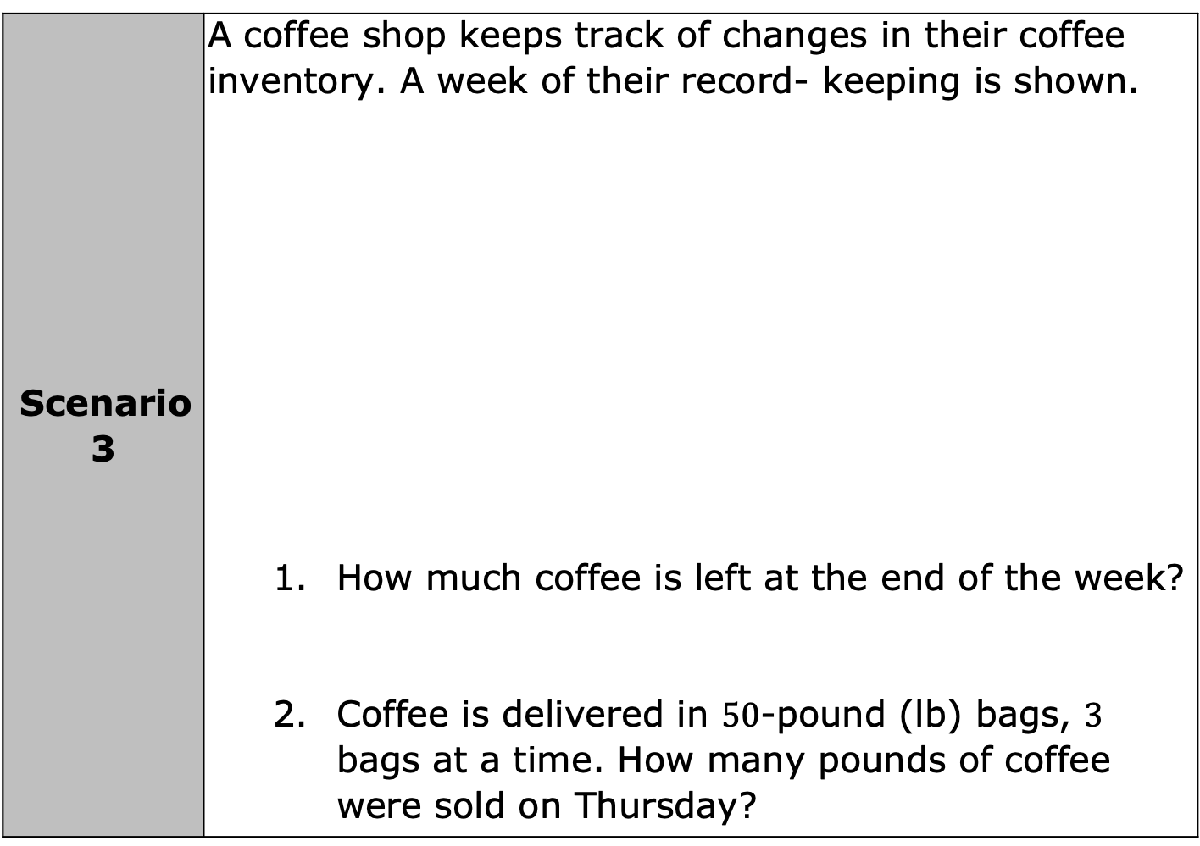
Scenario 3 | A coffee shop keeps track of changes in their coffee inventory. A week of their record- keeping is shown. How much coffee is left at the end of the week? Coffee is delivered in $50$-pound (lb) bags, $3$ bags at a time. How many pounds of coffee were sold on Thursday?
Day | Change in Inventory (lb)
Monday | $$150$$
Tuesday | $$−43.3$$
Wednesday | $$−50.5$$
Thursday | $$72.8$$
Friday | $$−52.7$$
Saturday | $$−21.6$$
Sunday | $$0$$
volume 2, pg. 197

Slide 13
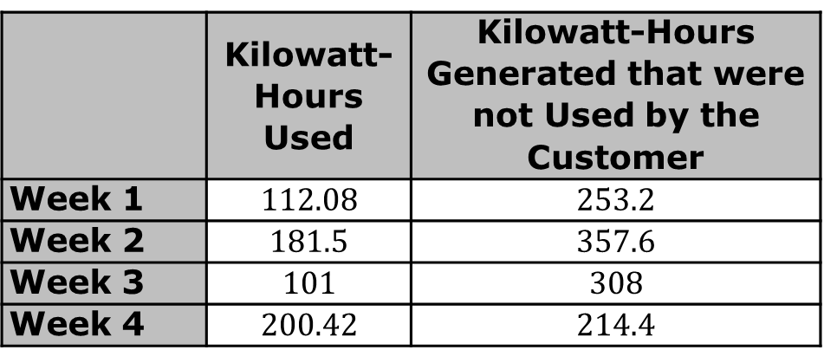
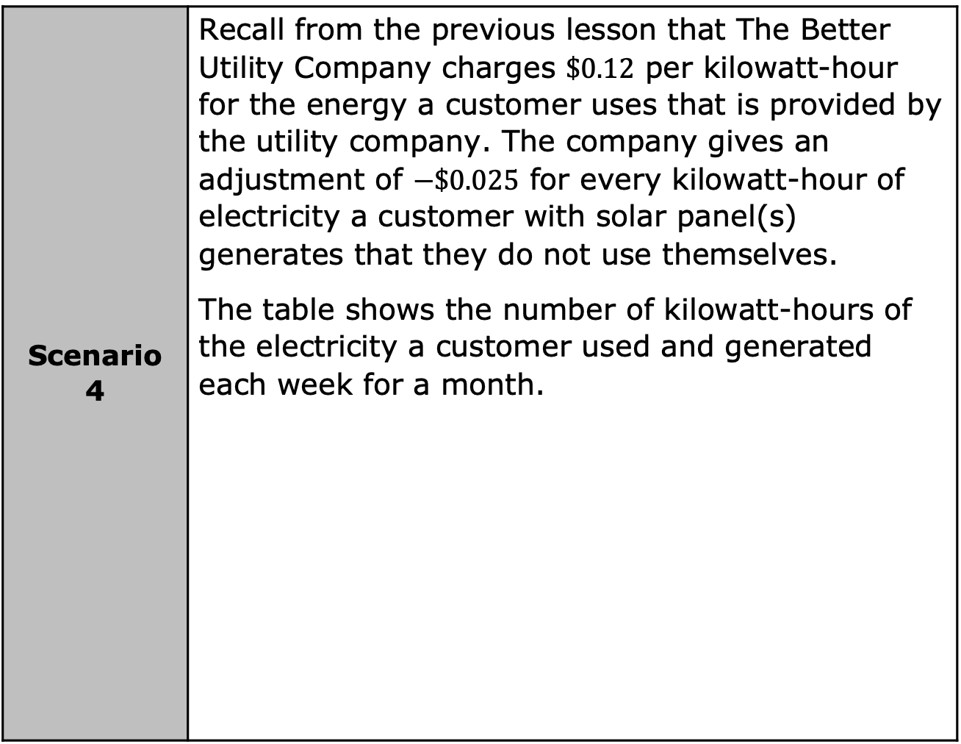
Scenario 4 | Recall from the previous lesson that The Better Utility Company charges $\$0.12$ per kilowatt-hour for the energy a customer uses that is provided by the utility company. The company gives an adjustment of $−\$0.025$ for every kilowatt-hour of electricity a customer with solar panel(s) generates that they do not use themselves. The table shows the number of kilowatt-hours of the electricity a customer used and generated each week for a month.
 | Kilowatt-Hours Used | Kilowatt-Hours Generated that were not Used by the Customer
Week 1 | $$112.08$$ | $$253.2$$
Week 2 | $$181.5$$ | $$357.6$$
Week 3 | $$101$$ | $$308$$
Week 4 | $$200.42$$ | $$214.4$$
volume 2, pg. 198

Slide 14
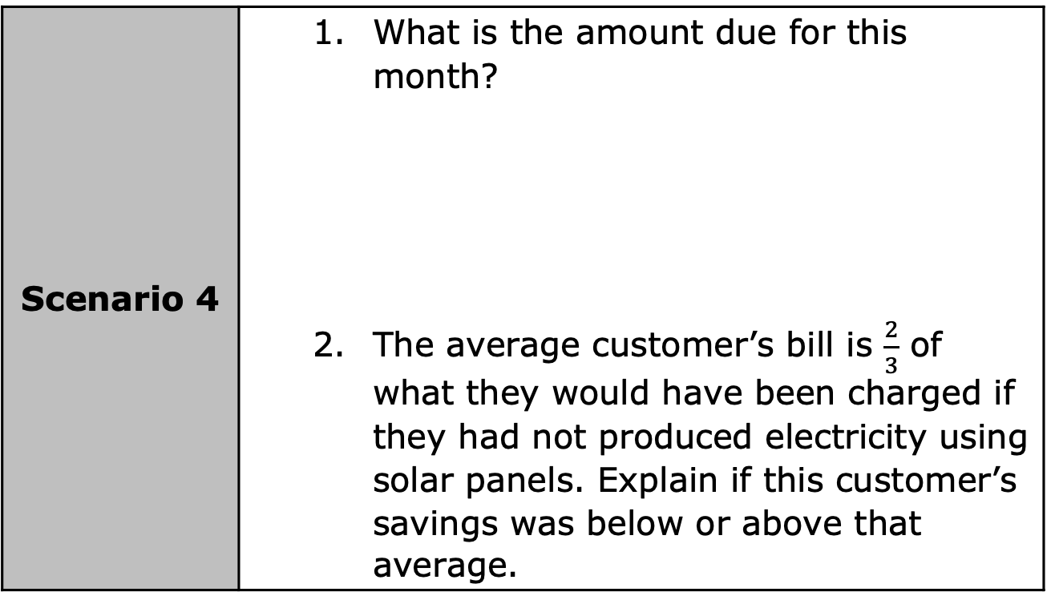
Scenario 4 | What is the amount due for this month? The average customer’s bill is $\frac{2}{3}$ of what they would have been charged if they had not produced electricity using solar panels. Explain if this customer’s savings was below or above that average.
volume 2, pg. 198

Slide 15

Your Turn
volume 2, pg. 198

Slide 16
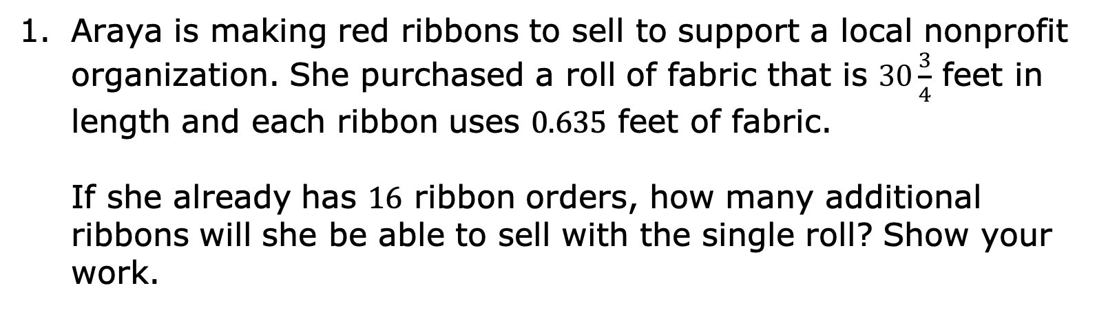
11.7.3 Your Turn!
Araya is making red ribbons to sell to support a local nonprofit organization. She purchased a roll of fabric that is $30\frac{3}{4}$ feet in length and each ribbon uses $0.635$ feet of fabric.
If she already has $16$ ribbon orders, how many additional ribbons will she be able to sell with the single roll? Show your work.
volume 2, pg. 198

Slide 17

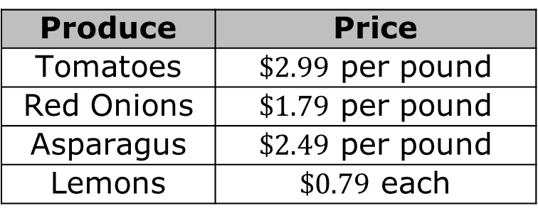
Joanne purchased $2\frac{1}{4}$ pounds of tomatoes, $3\frac{1}{8}$ pounds of red onions, $\frac{3}{4}$ pounds of asparagus, and $3$ lemons from a grocery store.
Based on the listed prices, how much would Joanne spend?
Produce | Price
Tomatoes | $\$2.99$ per pound
Red Onions | $\$1.79$ per pound
Asparagus | $\$2.49$ per pound
Lemons | $\$0.79$ each
volume 2, pg. 198

Slide 18

Wrap-Up
volume 2, pg. 199

Slide 19
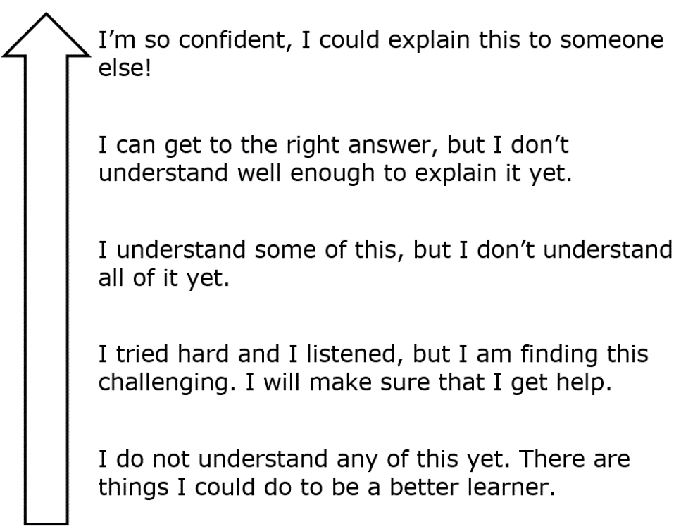
11.7.4 Wrap-Up: Reflection
Color in the arrow up to the statement which best describes your current understanding of solving real-world problems with rational numbers.
volume 2, pg. 199

